Slide 1
Civic Product Management – The Art and Science of Writing Requirements in the Public Interest
Bianca Wylie
Tech Reset Canada/Digital Public/Senior Fellow, CIGI
Thursday March 3, 2022
@biancawylie

Slide 2
How We’ll Spend Our Time Together
20 min speaking, 30 min conversation
Contending with the Novelty Scam and Filling the Gap
The 2022 Situation
My Product Management Story
Civic Product Management – Why? What to take (relationships, residents (end users), and requirements). What to leave (novelty, agile, and pretending) Why? Accountability
Operations and Culture - Relationship building, Policy, Programs, Corporate, Operations
(Re)-Introducing The Public Service – Rejecting Translation and Related Theatre
Pro-public Efficiency vs. Anti-social Efficiency - Commercial profit vs Public sector efficiency

Slide 3
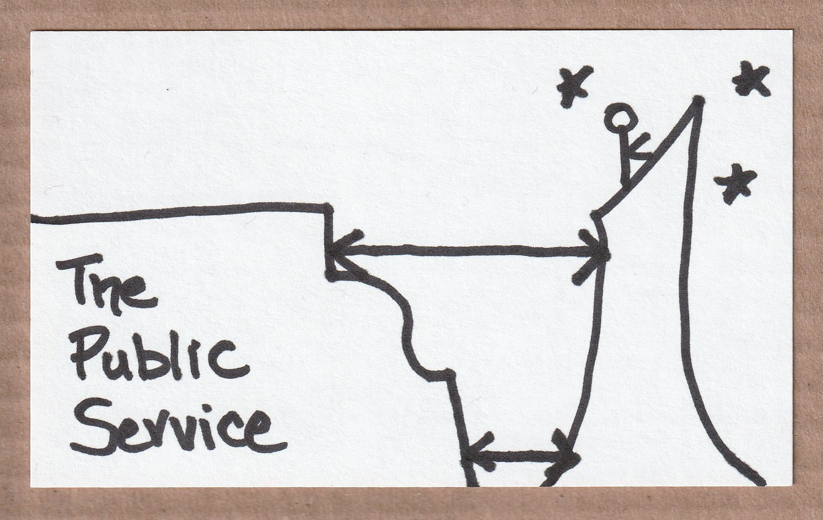
Contending With The Love of Novelty
Practicing The Art of Remembering
Contending with the Novelty Scam
and Filling the Gap

Slide 4
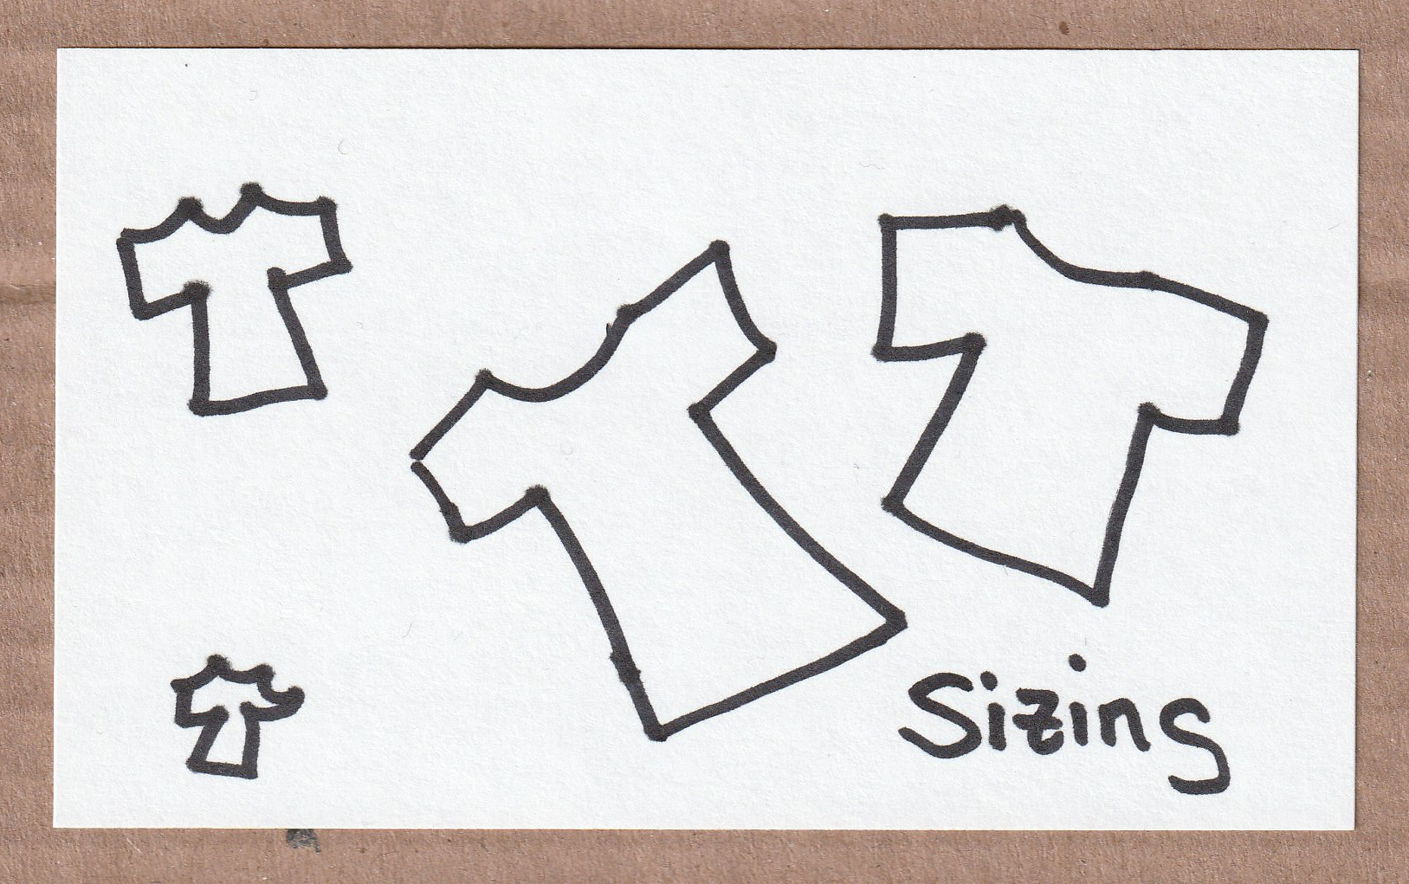
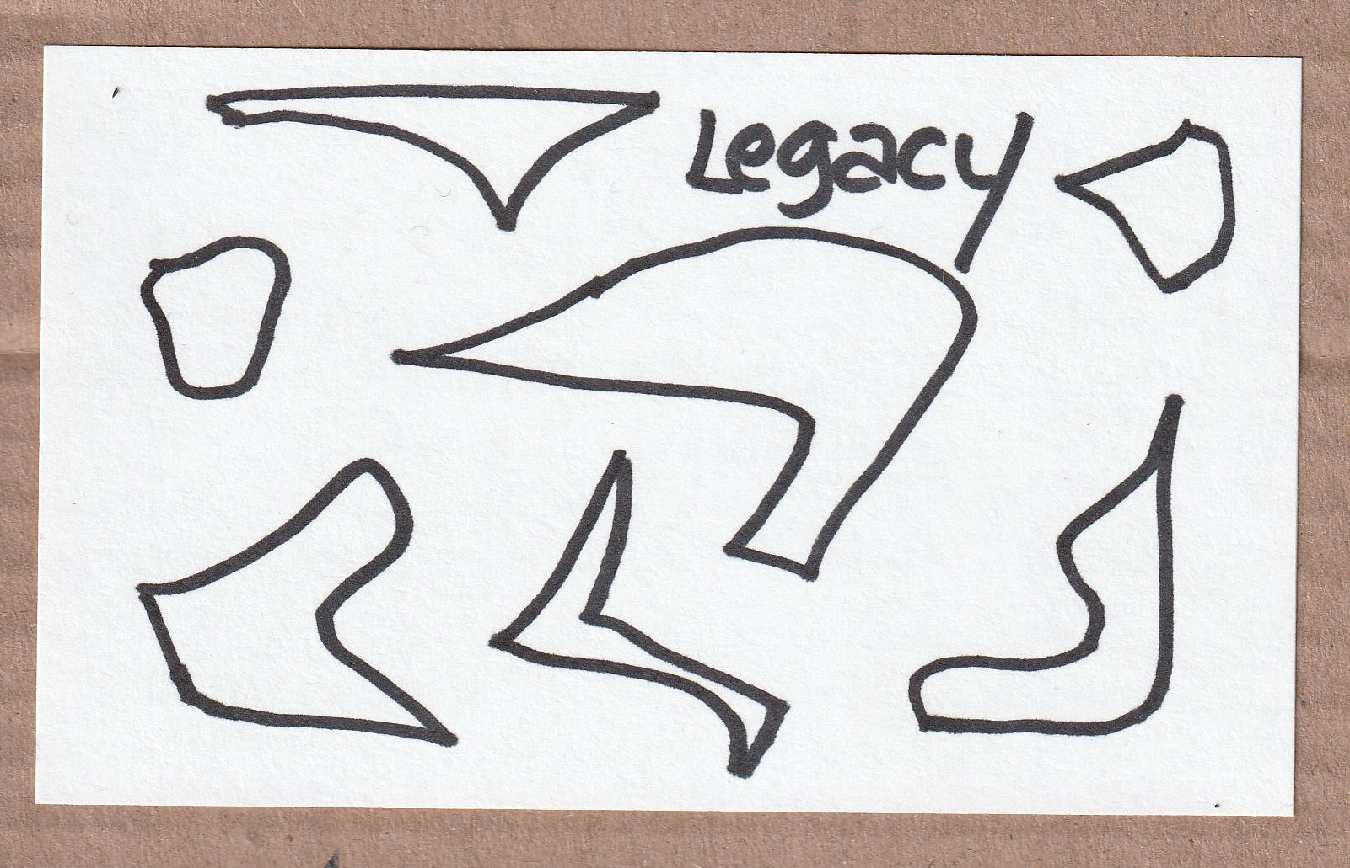
The 2022 Situation
My Product Management Story

Slide 5
Civic Product Management – Why?
Accountability and Memory and Overdue Change
What to take (relationships, residents (end users), and requirements)
What to leave (novelty, agile, and pretending)

Slide 6
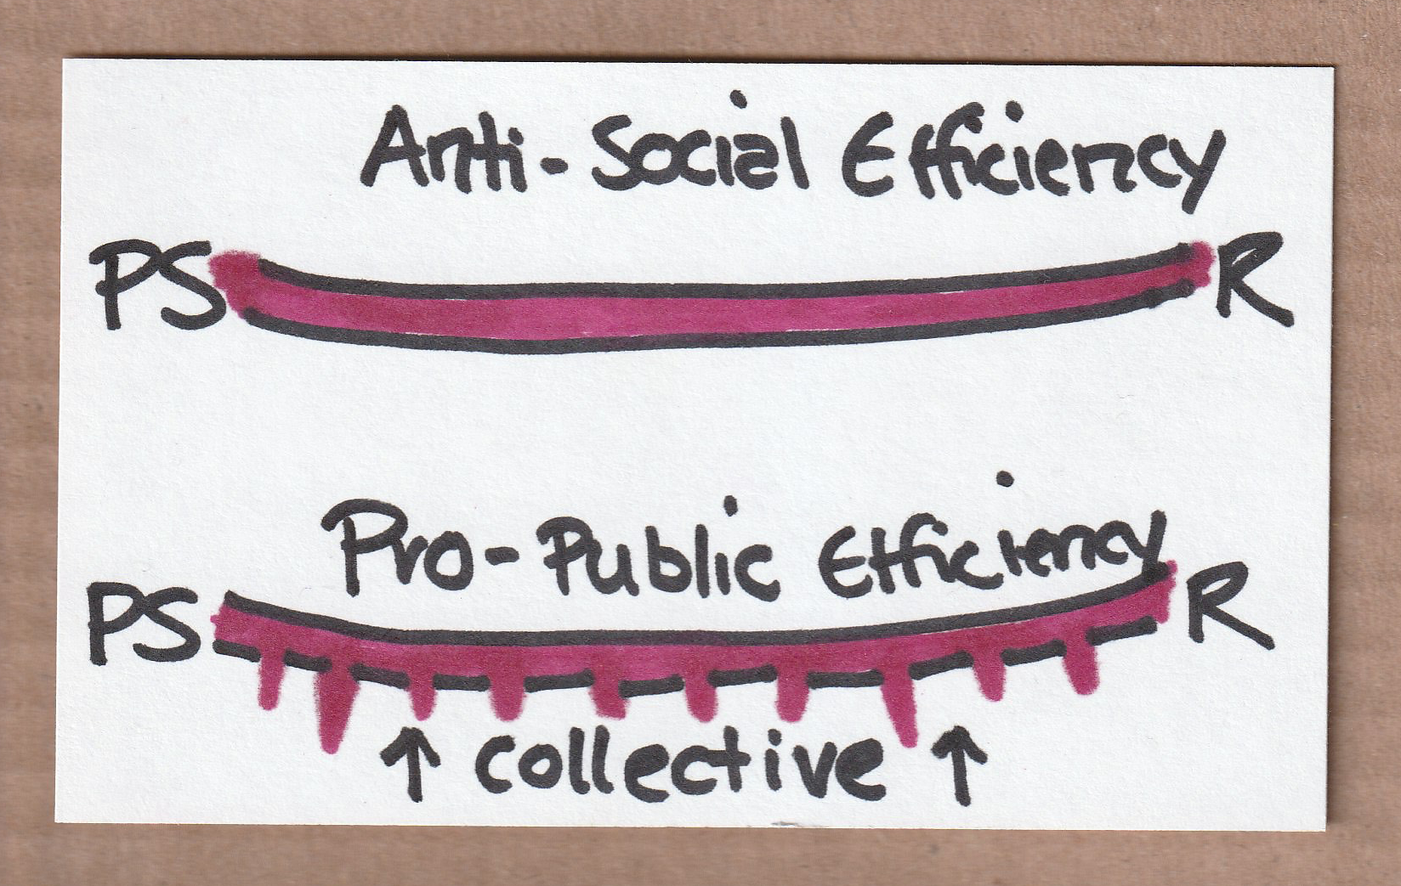
2022 – Science/Culture/Operations
(Re)-Introducing The Public Service
Rejecting Translation and Related Theatre
Pro-public Efficiency vs. Anti-social Efficiency
Commercial profit vs Public sector Efficiency

Slide 7
Thank You :) Conversation Time

